Slide 1
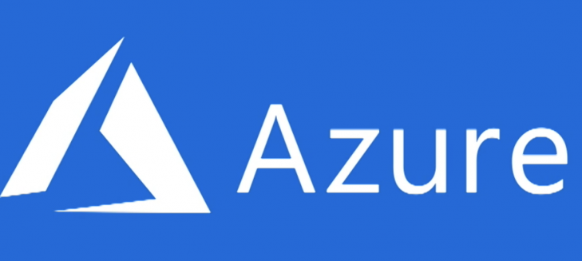
Microsoft Azure Fundamentals

Slide 2
About Presenters
Name: Abdul Khadar
Designation: Software Engineer
Team: Cloud COE
Experience: 1 year
Expertise: Azure, Azure DevOps
Name: Manoharan Nagaraj
Designation: Tech Lead
Team: Cloud COE
Experience: 14 years
Expertise: Azure, Containerization platforms

Slide 3
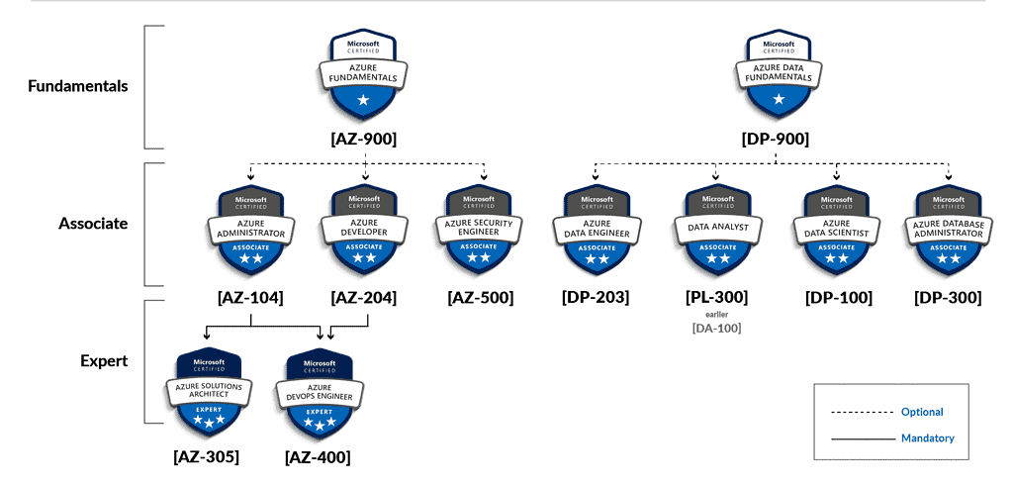
Why Azure Fundamentals AZ-900

Slide 4
Learning Path for Azure Fundamentals
Skills Required & Weightage
Exam
Certification
Cloud Concepts (25-30%)
Azure Management and Governance (30-35%)
AZ-900: Microsoft Azure Fundamentals
Microsoft Certified: Azure Fundamentals
Start Here
Azure Architecture and Services (35-40%)

Slide 5
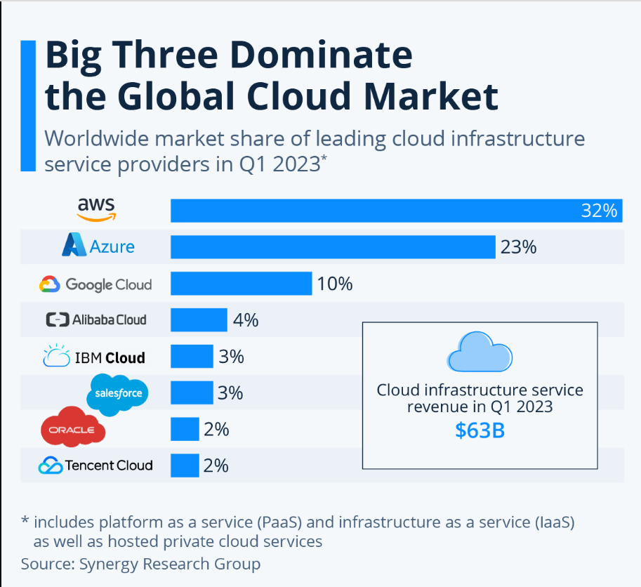

Slide 6
Module | Topics
1 | Cloud Concepts
2 | Azure Architecture and Services
3 | Azure Management and Governance

Slide 7
1. Cloud Concepts
Cloud Computing
Benefits of using Cloud Services
Cloud Service Types
Notes:
Adjust the title page for AZ-900T00 or AZ-900T01.

Slide 8
1.A. Cloud Computing
Cloud Computing
Shared Responsibility Model
Cloud Models – Public, Private, and Hybrid
Appropriate use cases for each Cloud Models
Consumption-based Model
Cloud Pricing Models
Notes:
Adjust the title page for AZ-900T00 or AZ-900T01.

Slide 9

On-Premise Data Center
Higher Capital Expenditure
Limited Scalability
Unreliability
Higher Maintenance
Higher Operational Expenses
Notes:
What are public, private, and hybrid clouds? - https://azure.microsoft.com/en-us/overview/what-are-private-public-hybrid-clouds/

Slide 10
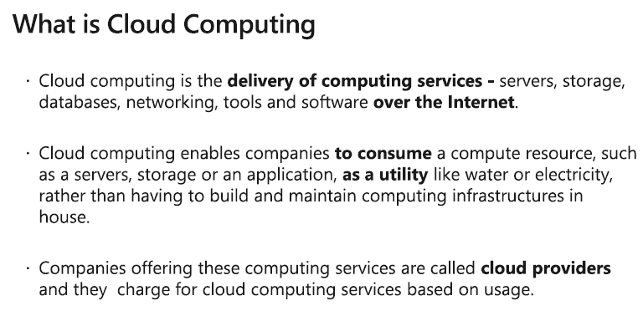
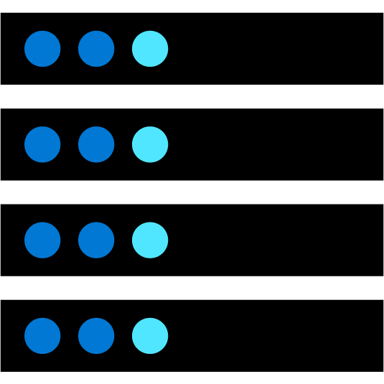

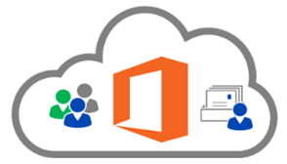


Cloud Computing
Compute
Storage
- such as Window/Linux servers or web applications.
- such as files and databases.
Cloud providers include Microsoft(Azure),
Amazon(AWS),
Google(GCP)
Networking
Analytics
- such as secure connections between the cloud provider and your company
- such as visualizing telemetry and performance data.
Notes:
Cloud computing - https://azure.microsoft.com/en-us/overview/what-is-cloud-computing/
Compute power - such as Linux servers or web applications.
Storage - such as files and databases.
Networking - such as secure connections between the cloud provider and your company.
Analytics - such as visualizing telemetry and performance data.

Slide 11
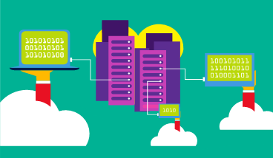
Cloud Models - Public Cloud
Owned by cloud services or hosting provider.
Provides resources and services to multiple organizations and users.
Accessed via secure network connection (typically over the internet).
Notes:
What are public, private, and hybrid clouds? - https://azure.microsoft.com/en-us/overview/what-are-private-public-hybrid-clouds/

Slide 12
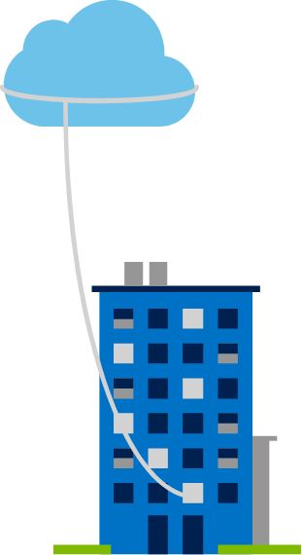
Cloud Models - Private Cloud
Organizations create a cloud environment in their datacenter.
Organizations responsible for operating the services they provide.
Does not provide access to users outside of the organization.
Notes:
Owned and operated by the organization.
Organizations create a cloud environment in their datacenter.
Self-service access to compute resources provided to users within the organization.
Organizations responsible for operating the services they provide.

Slide 13
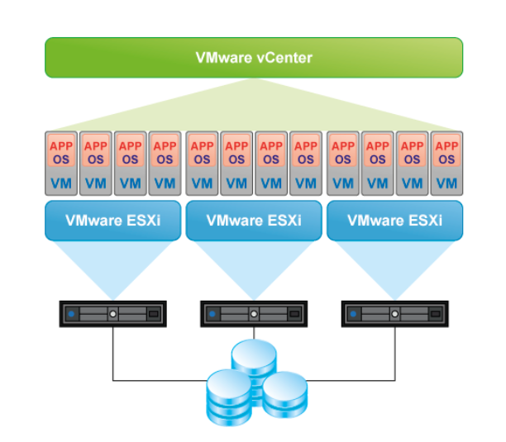
Virtualization Platform

Slide 14
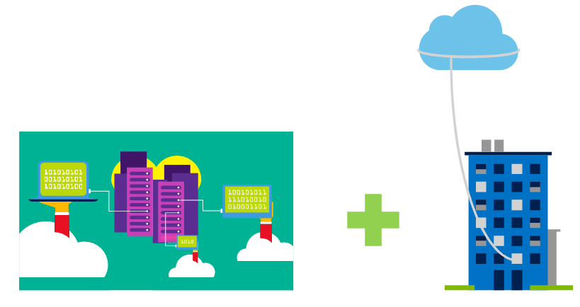
Cloud Models - Hybrid Cloud
Hybrid cloud models have the following characteristics:
Resource location. Specific resources run or are used in a public cloud, and others run or are used in a private cloud.
Cost and efficiency. Hybrid cloud models allow an organization to leverage some of the benefits of cost, efficiency, and scale that are available with a public cloud model.
Control. Organizations retain management control in private clouds.
Skills. Technical skills are still required to maintain the private cloud and ensure both cloud models can operate together.
Combines Public and Private clouds to allow applications to run in the most appropriate location.
Notes:
Hybrid cloud models have the following characteristics:
Resource location. Specific resources run or are used in a public cloud, and others run or are used in a private cloud.
Cost and efficiency. Hybrid cloud models allow an organization to leverage some of the benefits of cost, efficiency, and scale that are available with a public cloud model.
Control. Organizations retain management control in private clouds.
Skills. Technical skills are still required to maintain the private cloud and ensure both cloud models can operate together.

Slide 15
Comparison of Cloud Models
Public cloud:
No capital expenditures to scale up.
Applications can be quickly provisioned and deprovisioned.
Organizations pay only for what they use.
Private cloud:
Hardware must be purchased for start-up and maintenance.
Organizations have complete control over security.
Hybrid cloud:
Provides the most flexibility.
Organizations determine where to run their applications.
Organizations control security, compliance, or legal requirements.
Organizations have complete control over resources.

Slide 16
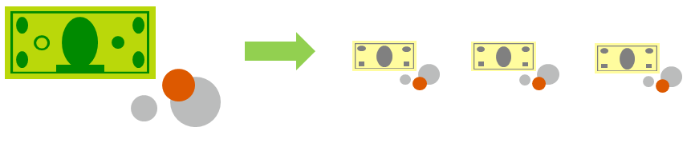
Compare CapEx vs. OpEx
Capital Expenditure (CapEx)
High upfront cost, value of investment reduces over time.
Operational Expenditure (OpEx)
Spend on services or products as needed.
No upfront cost, pay-as-you use.

Slide 17
Consumption-based model
Cloud service providers operate on a consumption-based model, which means that end users only pay for the resources that they use. Whatever they use is what they pay for.
Better cost prediction
Prices for individual resources and services are provided
Billing is based on actual usage
Notes:
This consumption-based model brings with it many benefits, including:
No upfront costs.
No need to purchase and manage costly infrastructure that they may or may not use to its fullest.
The ability to pay for additional resources when they are needed.
The ability to stop paying for resources that are no longer needed.

Slide 18
1.B. Benefits of Cloud
Fault tolerance
High availability
Fault tolerance
Scalability
Elasticity
Global reach
Customer latency capabilities
Agility
Predictive cost considerations
Disaster recovery
Security
Notes:
IaaS, PaaS, and SaaS have dedicated topics, coming up.

Slide 19
1.C. Cloud Services Types
Infrastructure as a Service (IaaS)
Platform as a Service (PaaS)
Software as a Service (SaaS)
Appropriate use cases for each Cloud Service (IaaS, PaaS, SaaS)
Notes:
Adjust the title page for AZ-900T00 or AZ-900T01.

Slide 20
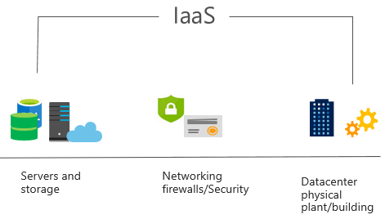
Infrastructure as a Service (IaaS)
Build pay-as-you-go IT infrastructure by renting servers, virtual machines, storage, networks, and operating systems from a cloud provider.
IaaS is the most basic category of cloud computing services.
With IaaS, you rent IT infrastructure servers, and virtual machines (VMs),storage, networks, and operating systems from a cloud provider on a pay-as-you-go basis. It's an instant computing infrastructure, provisioned and managed over the internet.
Notes:
For more information on IaaS, visit https://azure.microsoft.com/en-us/overview/what-is-iaas/
Most basic cloud computing services category.
Build pay-as-you-go IT infrastructure by renting servers, virtual machines, storage, networks, and operating systems from a cloud provider.
Instant computing infrastructure, provisioned and managed over the internet.

Slide 21
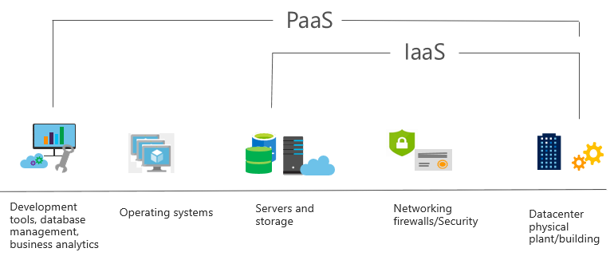
Platform as a Service (PaaS)
PaaS provides an environment for building, testing, and deploying software applications. The goal of PaaS is to help create an application as quickly as possible without having to focus on managing the underlying infrastructure.
Notes:
For more information on PaaS, see https://azure.microsoft.com/en-us/overview/what-is-paas/
Provides environment for building, testing, and deploying software applications.
Helps create applications quickly, without focusing on managing underlying infrastructure.

Slide 22
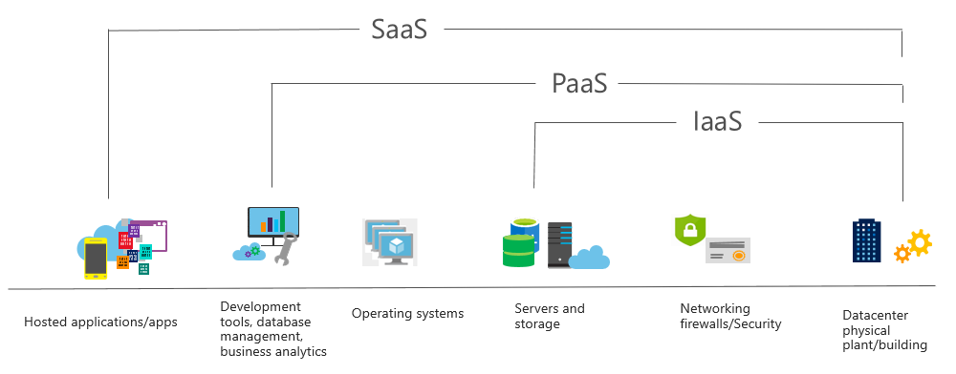
Software as a Service (SaaS)
Users connect to and use cloud-based apps over the internet: for example, Microsoft Office 365, email, and calendars.
SaaS is software that is centrally hosted and managed for the end customer. It allows users to connect to and use cloud-based apps over the internet. Common examples are email, calendars, and office tools such as Microsoft Office 365.
Notes:
Common usage scenarios:
Examples of Microsoft SaaS services include Microsoft Office 365, Skype, and Microsoft Dynamics CRM Online.
For more information on SaaS, see https://azure.microsoft.com/en-us/overview/what-is-saas/

Slide 23
Compare Cloud Services Types
IaaS
PaaS
SaaS
The most flexible cloud service.
You configure and manage the hardware for your application.
Focus on application development.
Platform management is handled by the cloud provider.
Pay-as-you-go pricing model.
Users pay for the software they use on a subscription model.
Notes:
The slide contains only some of the cloud service comparison discussion points.

Slide 24
Shared Responsibility Model
On-Premises
( Private Cloud )
Infrastructure
( as a Service )
Platform
( as a Service )
Software
( as a Service )
IaaS requires the most user management of all the cloud services. The user is responsible for managing the operating systems, data, and applications.
PaaS requires less user management. The cloud provider manages the operating systems, and the user is responsible for the applications and data they run and store.
SaaS requires the least amount of management. The cloud provider is responsible for managing everything, and the end user just uses the software.
Data & Access
Data & Access
Data & Access
Data & Access
Applications
Applications
Applications
Applications
You Manage
Runtime
Runtime
Runtime
Runtime
Cloud Provider Manages
Operating System
Operating System
Operating System
Operating System
Virtual Machine
Virtual Machine
Virtual Machine
Virtual Machine
Compute
Compute
Compute
Compute
Networking
Networking
Networking
Networking
Storage
Storage
Storage
Storage
Notes:
IaaS, PaaS, and SaaS have dedicated topics, coming up.

Slide 25
2.A. Core Architectural Components of Azure
Regions and Region Pairs
Availability Zones
Azure Datacenters
Azure Resources & Resource Groups
Subscriptions
Azure Management Groups
Hierarchy of resource groups, subscriptions, and management groups

Slide 26
Geographies
• A geography is a discrete market typically containing two or more
regions that preserves data residency and compliance boundaries
• Geographies allow customers with specific data-residency and
compliance needs to keep their data and applications close
• Geographies are broken up into Americas, Europe, Asia Pacific, Middle
East, and Africa
Regions
• Azure is made up of datacenters located around the globe. These
datacenters are organized and made available to end users by
country/region
• In reference to datacenters, a region is a geographical area on the planet
containing at least one—but potentially multiple —datacenters that are
in close proximity and networked together with a low-latency network
Region Pair
• Each Azure region is paired with another region within the same
geography (such as US, Europe, or Asia).
• This approach allows for the replication of resources (such as virtual
machine (VM) storage) across a geography that helps reduce the
likelihood of interruptions due to events such as natural disasters,
power outages, or physical network outages affecting both regions at
once.

Slide 27
Geographies
Discrete markets that preserve data residency and compliance boundaries.
Typically contain two or more regions.
Allow customers with specific data-residency and compliance needs to keep their data and applications in close proximity.
Categorized as Americas, Europe, Asia Pacific, Middle East, and Africa.
Notes:
A list of geography locations is available at : https://azure.microsoft.com/en-us/global-infrastructure/geographies/

Slide 28
Regions
A region represents a collection of data centers.
Provides flexibility and scale.
Preserves data residency.
Select regions close to your users.
Be aware of region deployment availability.
There are global services that are region independent.
Worldwide there are 54 regions representing 140 countries
Azure global infrastructure experience - https://datacenters.microsoft.com/globe/explore
Notes:
A list of regions and their locations is available at https://datacenters.microsoft.com/globe/explore

Slide 29
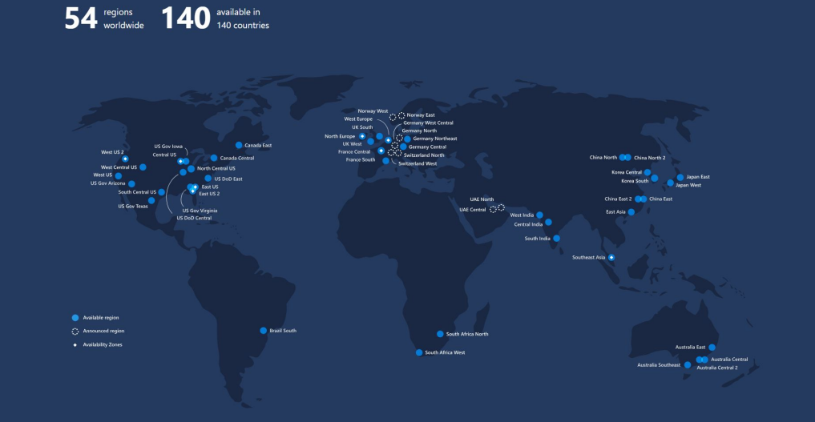

Slide 30
Region Pairs
Each Azure region is paired with another region.
Azure prefers at least 300 miles of separation between datacenters in a regional pair.
Some services provide automatic replication to the paired region.
In an outage, recovery of one region is prioritized out of every pair.
Azure system updates are rolled out to paired regions sequentially (not at the same time).
Paired regions are members of the same geography – except Brazil.
Region
North Central US​
East US​
West US 2​
US East 2​
Canada Central​
North Europe​
UK West​
Germany Central​
South East Asia​
East China​
Japan East​
Australia Southeast​
India South​
Brazil South (Primary)​
Region
South Central US​
West US​
West Central US​
Central US​
Canada East​
West Europe​
UK South​
Germany Northeast​
East Asia​
North China​
Japan West​
Australia East​
India Central​
South Central US ​
Notes:
A full list of region pairs is available at https://docs.microsoft.com/en-us/azure/best-practices-availability-paired-regions#what-are-paired-regions

Slide 31
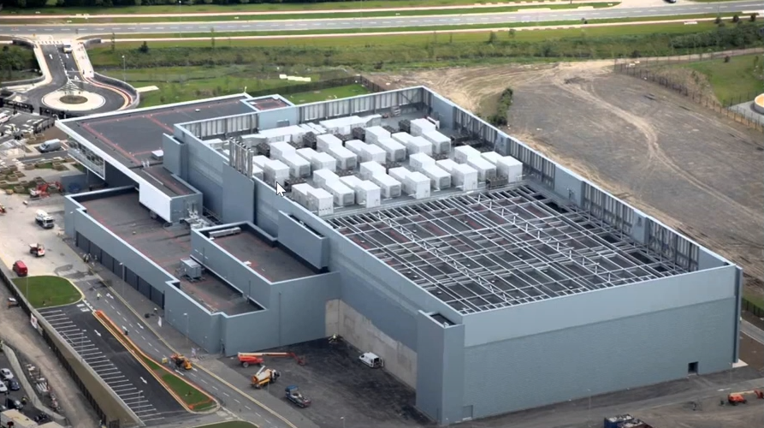
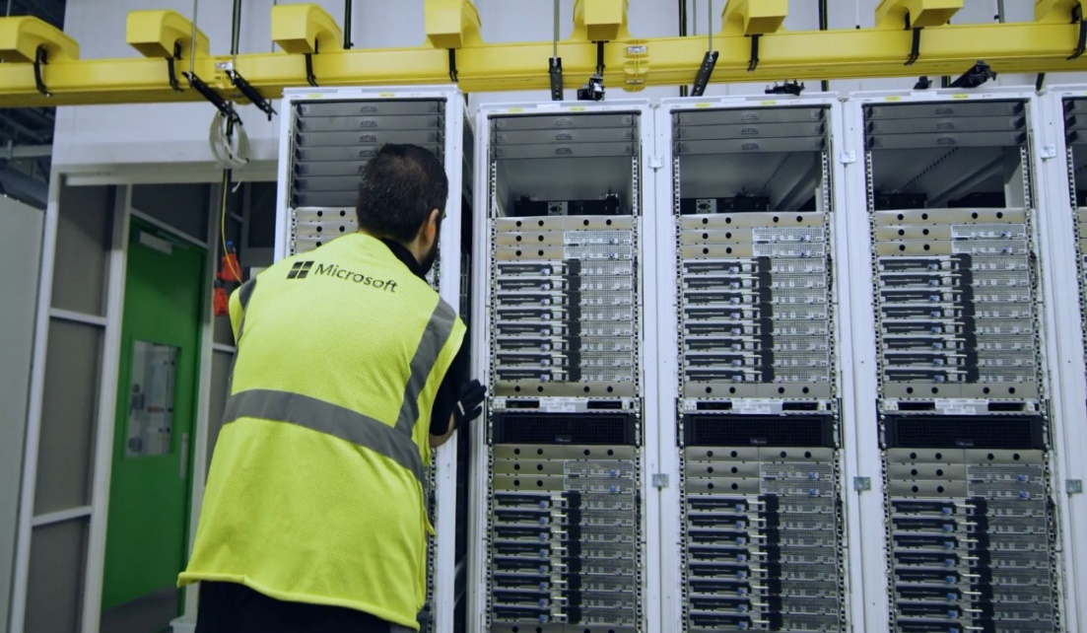
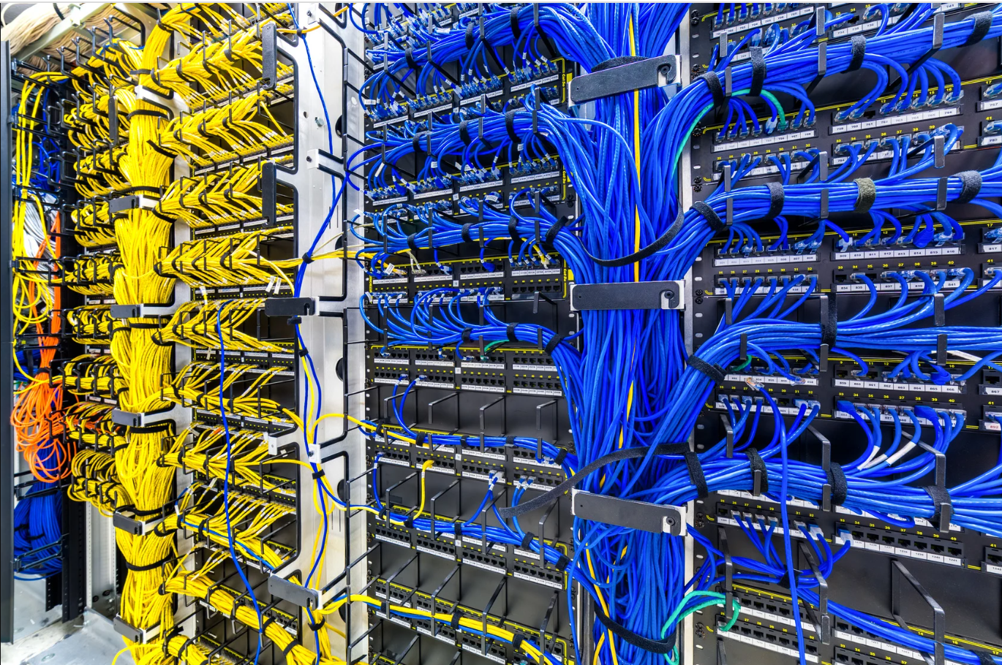
Datacenter
Server Rack
Cabling

Slide 32
Availability Options
VM SLA
VM SLA
VM SLA
MULTI-REGION DISASTER RECOVERY
99.9% with Premium Storage
99.95%
99.99%
Region 1
Region 2
SINGLE VM
AVAILABILITY SETS
AVAILABILITY ZONES
REGION PAIRS
Easier lift and shift
Protecting against failures within datacenters
Protection from entire datacenter failures
Regional protection within Data Residency Boundaries
Notes:
This slide is to introduce the upcoming topics. You could also use the slide at the end of the lesson to review.

Slide 33






Azure Resources
Azure resources are components like storage, virtual machines, and networks that are available to build cloud solutions.
Virtual Machines
Storage Accounts
Virtual Networks
App Services
SQL Databases
Functions
Notes:
Learn and SkillPipe content order note:
Slides 11-13
https://docs.microsoft.com/en-us/learn/modules/azure-architecture-fundamentals/resources-resource-manager

Slide 34



Resource groups
Resource groups (web + DB, VM, Storage) in one group
Containers for multiple resources that share the same life cycle.
Aggregates resources into a single manageable unit.
Every Azure resource must exist in one (and only one) resource group.
Secure at the resource group (or resource) level - using role-based access control (RBAC).
OR
Web and DB resource group
Virtual machine resource group
Storage resource group

Slide 35
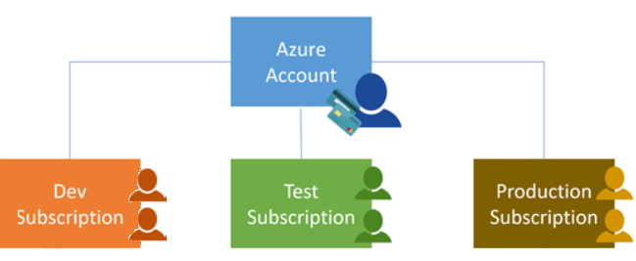
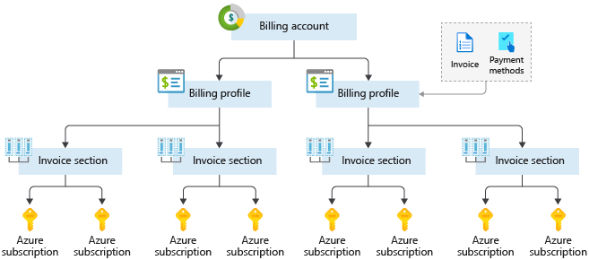
Azure Subscriptions
An Azure subscription provides you with authenticated and authorized access to Azure accounts.
Billing boundary: generate separate billing reports and invoices for each subscription.
Access control boundary: manage and control access to the resources that users can provision with specific subscriptions.
Notes:
An account can have one subscription or multiple subscriptions.
Azure subscription offers - https://azure.microsoft.com/en-us/support/legal/offer-details/
Learn and SkillPipe content order note:
Slides 14 & 16
https://docs.microsoft.com/en-us/learn/modules/azure-architecture-fundamentals/management-groups-subscriptions

Slide 36
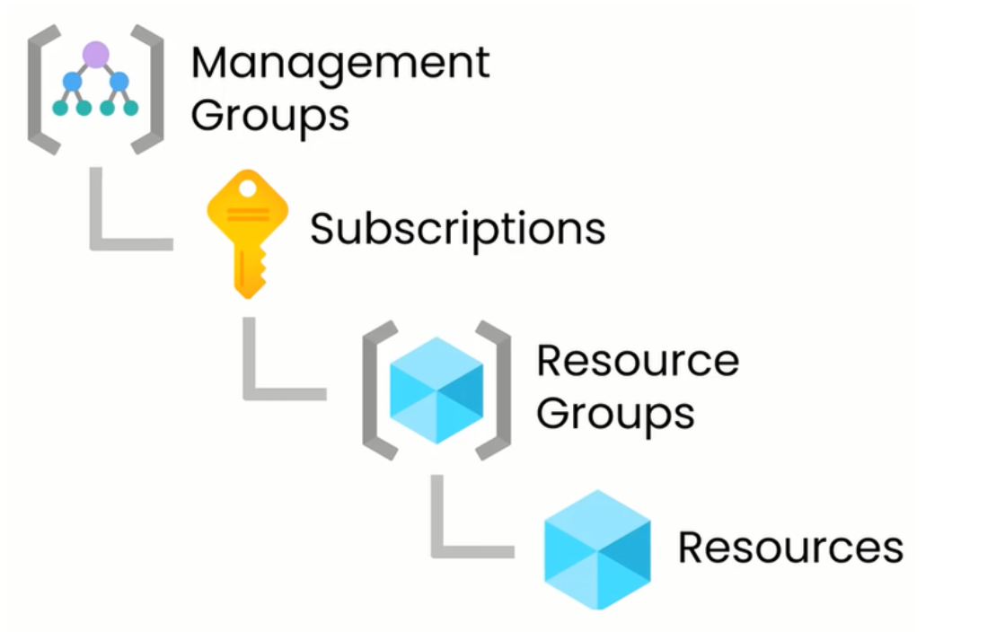
Azure Management Groups
Management groups can include multiple Azure subscriptions.
Subscriptions inherit conditions applied to the management group.
10,000 management groups can be supported in a single directory.
A management group tree can support up to six levels of depth.
Notes:
Management groups can include multiple Azure subscriptions.
Subscriptions inherit conditions applied to the management group.
10,000 management groups can be supported in a single directory.
A management group tree can support up to six levels of depth.
Management groups - https://docs.microsoft.com/en-us/azure/governance/management-groups/
Learn and SkillPipe content order note:
Slides 14 & 16
https://docs.microsoft.com/en-us/learn/modules/azure-architecture-fundamentals/management-groups-subscriptions

Slide 37
Azure Services
Compute
Networking
Storage
Mobile
Databases
Web
Internet of Things (IoT)
Big data
AI
DevOps

Slide 38
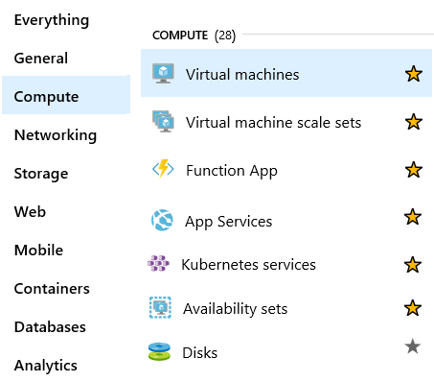
Azure Compute Services
On-demand computing service for running cloud-based applications.
Provides computing resources such as disks, processors, memory, networking, and operating systems.
Makes resources available in minutes or seconds.
Lots of on-demand services.
Pay-per-use.
Notes:
For a full list of compute services available with Azure and the context on when to use them, visit https://azure.microsoft.com/en-us/product-categories/compute/

Slide 39

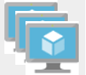

Azure Compute Services
Azure VMs use Infrastructure as a Service (IaaS) to provide computing power in the cloud.
VM Scale Sets are designed for automatic scaling of identical VMs.
App Services is a Platform as a Service (PaaS) offering to build, deploy, and scale enterprise-grade web, mobile, and API apps.
Functions perform compute actions based on an event.
Notes:
Azure virtual machines - https://azure.microsoft.com/en-us/services/virtual-machines/
Virtual machine scale sets - https://azure.microsoft.com/en-us/services/virtual-machine-scale-sets/
App services - https://azure.microsoft.com/en-us/services/app-service/
Azure Functions - https://azure.microsoft.com/en-us/services/functions/

Slide 40
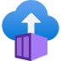
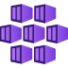
Azure Compute Services
Azure Container Instances: a PaaS offering that runs a container in Azure without the need to manage a virtual machine or additional services.
Azure Kubernetes Service: an orchestration service for containers with distributed architectures and large volumes of containers.
Notes:
Azure virtual machines - https://azure.microsoft.com/en-us/services/virtual-machines/
Virtual machine scale sets - https://azure.microsoft.com/en-us/services/virtual-machine-scale-sets/
App services - https://azure.microsoft.com/en-us/services/app-service/
Azure Functions - https://azure.microsoft.com/en-us/services/functions/

Slide 41
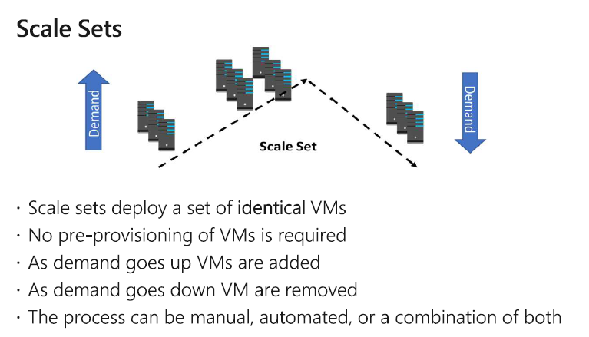
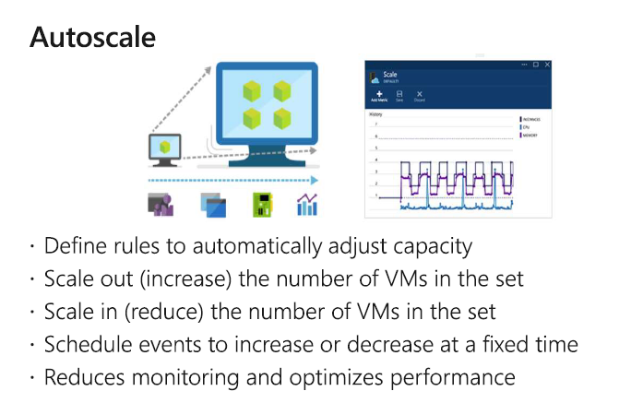

Slide 42



Azure Network Services
Azure Virtual Network enables Azure resources to communicate with each other, the internet, and on-premises networks.
Subnet is a range of IP addresses in the virtual network. You can divide a virtual network into multiple subnets for organization and security. Each NIC in a VM is connected to one subnet in one virtual network.
Azure Load Balancer automatically scales to create highly-available access to applications or resources.
Notes:
Virtual Networks - https://azure.microsoft.com/en-us/services/virtual-network/
Azure Load Balancer - https://azure.microsoft.com/en-us/services/load-balancer/
VPN gateway - https://azure.microsoft.com/en-us/services/vpn-gateway/
Azure Application Gateway - https://azure.microsoft.com/en-us/services/application-gateway/
Content Delivery Network - https://azure.microsoft.com/en-us/services/cdn/
Networking - https://azure.microsoft.com/en-us/product-categories/networking/

Slide 43



Azure Network Services
VPN Gateway is used to send encrypted traffic between an Azure virtual network and an on-premises location over the public internet.
Azure Express Route extends on-premises networks into Azure over a private connection that is facilitated by a connectivity provider.
Content Delivery Network provides a distributed network of servers that efficiently deliver web content in their local region.
Notes:
Virtual Networks - https://azure.microsoft.com/en-us/services/virtual-network/
Azure Load Balancer - https://azure.microsoft.com/en-us/services/load-balancer/
VPN gateway - https://azure.microsoft.com/en-us/services/vpn-gateway/
Azure Application Gateway - https://azure.microsoft.com/en-us/services/application-gateway/
Content Delivery Network - https://azure.microsoft.com/en-us/services/cdn/
Networking - https://azure.microsoft.com/en-us/product-categories/networking/

Slide 44
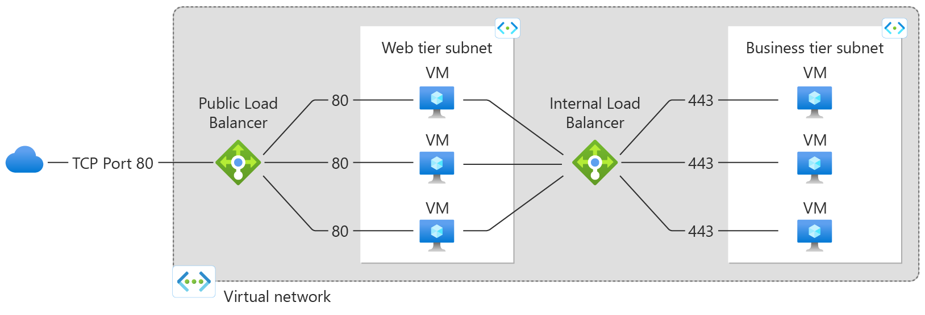
Azure Load Balancer
Notes:
Virtual Networks - https://azure.microsoft.com/en-us/services/virtual-network/
Azure Load Balancer - https://azure.microsoft.com/en-us/services/load-balancer/
VPN gateway - https://azure.microsoft.com/en-us/services/vpn-gateway/
Azure Application Gateway - https://azure.microsoft.com/en-us/services/application-gateway/
Content Delivery Network - https://azure.microsoft.com/en-us/services/cdn/
Networking - https://azure.microsoft.com/en-us/product-categories/networking/

Slide 45
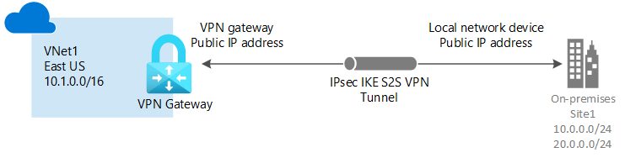
Azure VPN Gateway
Notes:
Virtual Networks - https://azure.microsoft.com/en-us/services/virtual-network/
Azure Load Balancer - https://azure.microsoft.com/en-us/services/load-balancer/
VPN gateway - https://azure.microsoft.com/en-us/services/vpn-gateway/
Azure Application Gateway - https://azure.microsoft.com/en-us/services/application-gateway/
Content Delivery Network - https://azure.microsoft.com/en-us/services/cdn/
Networking - https://azure.microsoft.com/en-us/product-categories/networking/

Slide 46
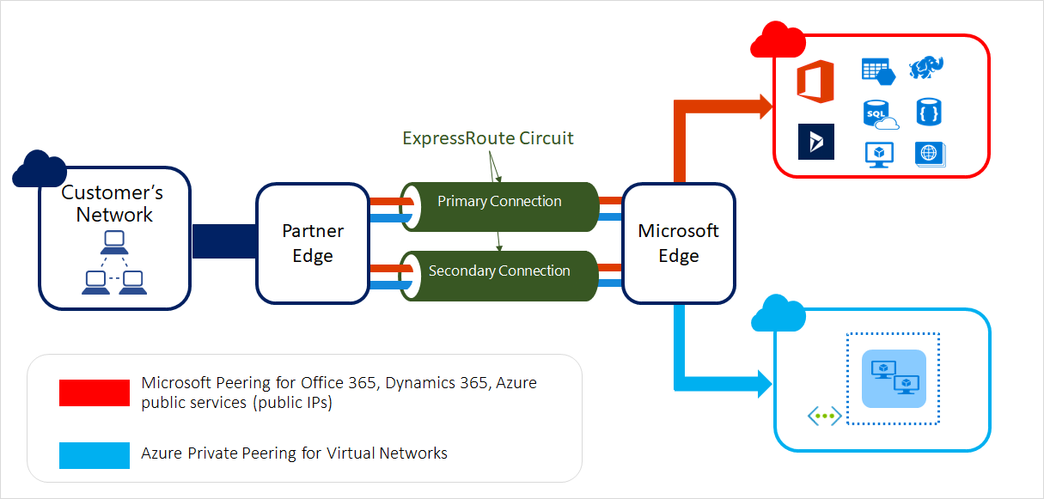
Azure Express Route
Notes:
Virtual Networks - https://azure.microsoft.com/en-us/services/virtual-network/
Azure Load Balancer - https://azure.microsoft.com/en-us/services/load-balancer/
VPN gateway - https://azure.microsoft.com/en-us/services/vpn-gateway/
Azure Application Gateway - https://azure.microsoft.com/en-us/services/application-gateway/
Content Delivery Network - https://azure.microsoft.com/en-us/services/cdn/
Networking - https://azure.microsoft.com/en-us/product-categories/networking/

Slide 47
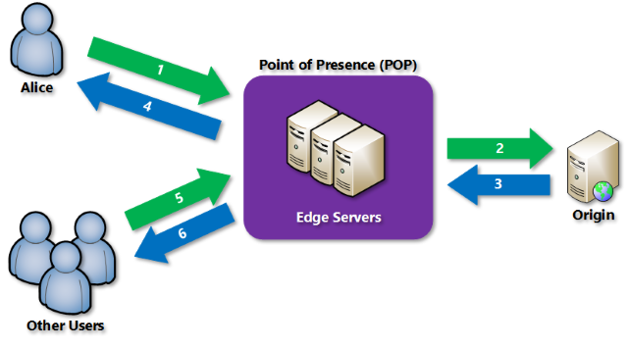
Azure Content Delivery Network (CDN)
Notes:
Virtual Networks - https://azure.microsoft.com/en-us/services/virtual-network/
Azure Load Balancer - https://azure.microsoft.com/en-us/services/load-balancer/
VPN gateway - https://azure.microsoft.com/en-us/services/vpn-gateway/
Azure Application Gateway - https://azure.microsoft.com/en-us/services/application-gateway/
Content Delivery Network - https://azure.microsoft.com/en-us/services/cdn/
Networking - https://azure.microsoft.com/en-us/product-categories/networking/

Slide 48
2.C. Azure Storage Services
Compare Azure Storage Services
Storage Tiers
Redundancy Options
Storage Account Options & Storage Types
Options for Moving Files, including AzCopy, Azure Storage Explorer
Migration Options, including Azure Migrate and Azure Data Box

Slide 49
Azure Storage account
A service that you can use to store files, messages, tables, and other types of information
A service that you can use to store files, messages, tables, and other types of information
Durable, secure, scalable, managed, accessible
Durable, secure, scalable, managed, accessible
Two tiers: Premium and Standard
Storage for virtual machines, unstructured data and structured data
Two tiers: Premium and Standard
Storage for virtual machines, unstructured data and structured data

Slide 50
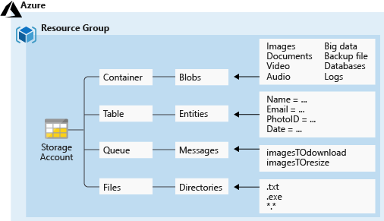
Azure Storage Services
Azure Containers: A massively scalable object store for text and binary data
Azure Tables: Ideal for storing structured, non-relational data
Azure Queues: A messaging store for reliable messaging between application components
Azure Files: Managed file shares for cloud or on-premises deployments

Slide 51
Access Storage
Every object has a unique URL address – based on account name and storage type
Container service: https://mystorageaccount.blob.core.windows.net
Table service: https://mystorageaccount.table.core.windows.net
Queue service: https://mystorageaccount.queue.core.windows.net
File service: https://mystorageaccount.file.core.windows.net
If you prefer you can configure a custom domain name
CNAME record | Target
blobs.contoso.com | contosoblobs.blob.core.windows.net

Slide 52
Azure Storage Access Tiers
Hot | Cool | Archive
Optimized for storing data that is accessed frequently. | Optimized for storing data that is infrequently accessed and stored for at least 30 days. | Optimized for storing data that is rarely accessed and stored for at least 180 days with flexible latency requirements.
You can switch between these access tiers at any time.

Slide 53
Storage Account Kinds
Storage Account | Recommended usage
Standard general-purpose v2 | Most scenarios including Blob, File, Queue, Table, and Data Lake Storage.
Premium block blobs | Block blob scenarios with high transactions rates, or scenarios that use smaller objects or require consistently low storage latency.
Premium file shares | Enterprise or high-performance file share applications.
Premium page blobs | Premium high-performance page blob scenarios.
✓
All storage accounts are encrypted using Storage Service Encryption (SSE) for data at rest

Slide 54
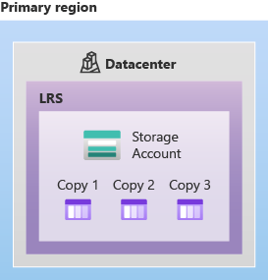
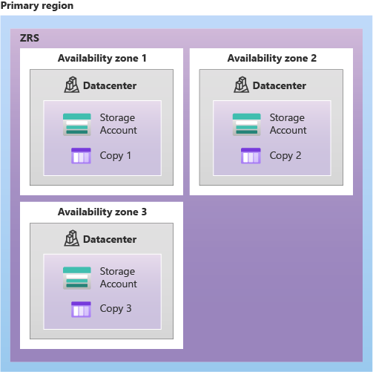
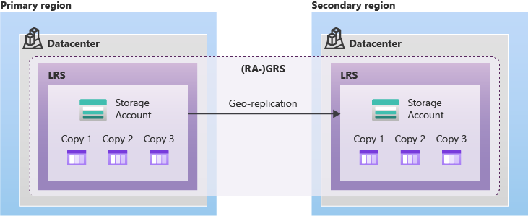
Redundancy Options (1 of 2)
LRS
ZRS
GRS, RA-GRS
SLA: 99.999999999% (11 nines)
SLA: 99.9999999999% (12 nines)
SLA: 99.99999999999999% (16 nines)
Continued next slide

Slide 55
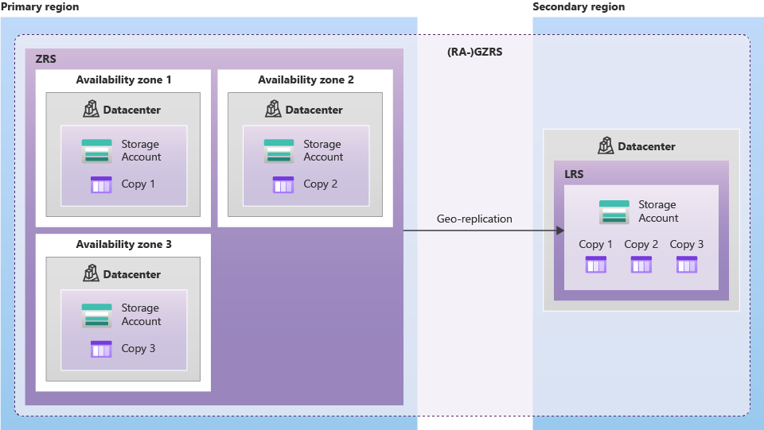
Redundancy Options (2 of 2)
GZRS, RA-GZRS
SLA: 99.99999999999999% (16 nines)
Continued next slide

Slide 56
AzCopy
azcopy copy [source] [destination] [flags]
Command line utility
Designed for copying data to and from Azure Blob, File, and Table storage
Available on Windows, Linux, and MacOS
Authentication options include Active Directory or SAS token

Slide 57
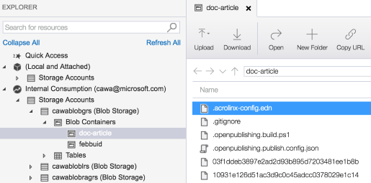
Azure Storage Explorer
Access multiple accounts and subscriptions
Create, delete, view, edit storage resources
View and edit Blob, Queue, Table, File, Cosmos DB storage and Data Lake Storage
Obtain shared access signature (SAS) keys
Available for Windows, Mac, and Linux

Slide 58
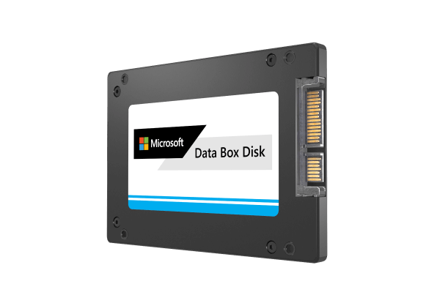
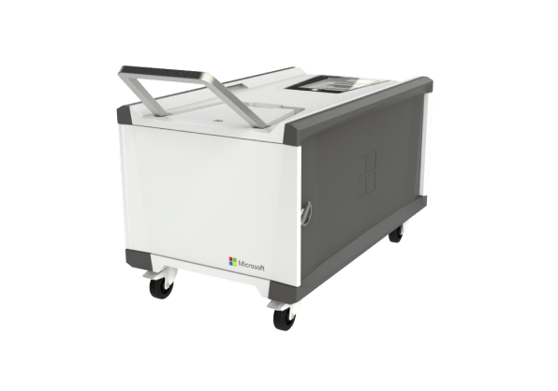
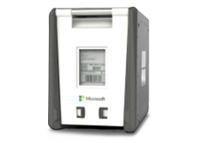
Azure Data Box
Lets you send terabytes of data into and out of Azure in a quick, inexpensive, and reliable way. The secure data transfer is accelerated by shipping you a proprietary Data Box storage device
Data Box Disk
Data Box
Data Box Heavy
8-TB SSD with a USB/SATA interface has 128-bit encryption.
Comes in packs of up to five for a total of 40 TB.
100-TB capacity uses standard NAS protocols and common copy tools.
It features AES 256-bit encryption for safer transit.
Self-contained device is designed to lift 1 PB of data to the cloud.

Slide 59
2.D. Azure Identity, Access, and Security
Azure Active Directory
Authentication Methods including SSO, MFA & Passwordless
Conditional Access
Azure Role-Based Access Control (RBAC)
Defense in depth model
Microsoft Defender for Cloud

Slide 60

Azure Active Directory (AAD)
Azure Active Directory (AAD) is Microsoft Azure’s cloud-based identity and access management service.
Authentication (employees sign-in to access resources).
Single sign-on (SSO).
Application management.
Business to Business (B2B).
Business to Customer (B2C) identity services.
Device management.

Slide 61









Compare Authentication and Authorization
Authentication Identifies the person or service seeking access to a resource.
Requests legitimate access credentials.
Basis for creating secure identity and access control principles.
Authorization Determines an authenticated person’s or service’s level of access.
Defines which data they can access, and what they can do with it.
Who are you?
What are you allowed to do?

Slide 62
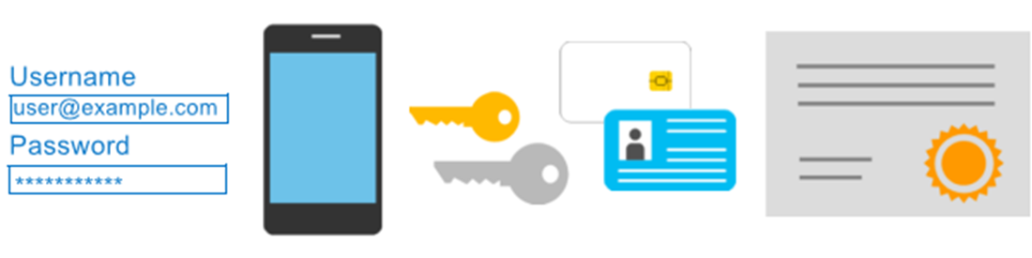
Azure Multi-Factor Authentication
Provides additional security for your identities by requiring two or more elements for full authentication.
Something you know ←→ Something you possess ←→ Something you are
(Password)
(Device)
(fingerprint or face scan)

Slide 63
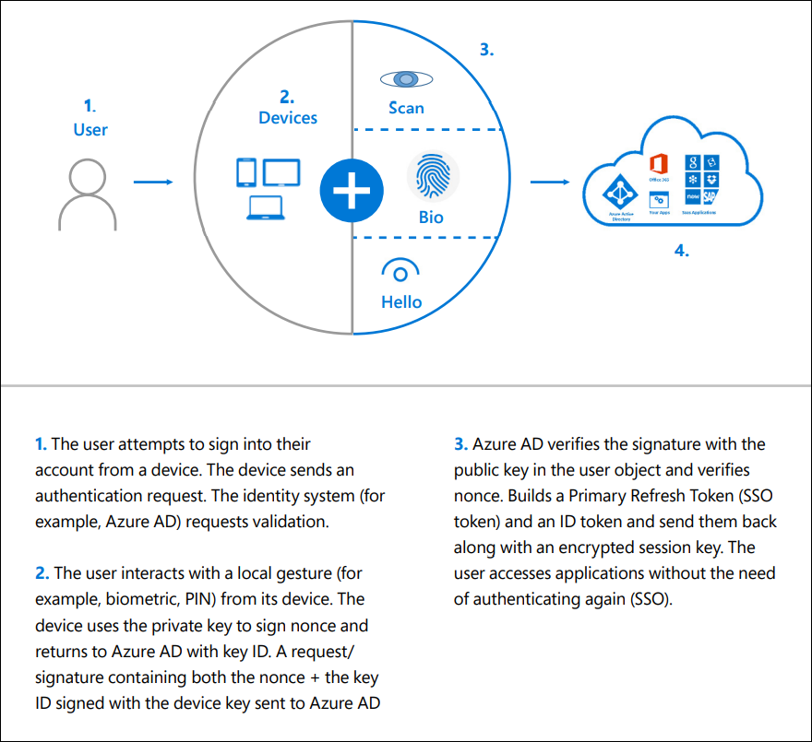
Passwordless

Slide 64
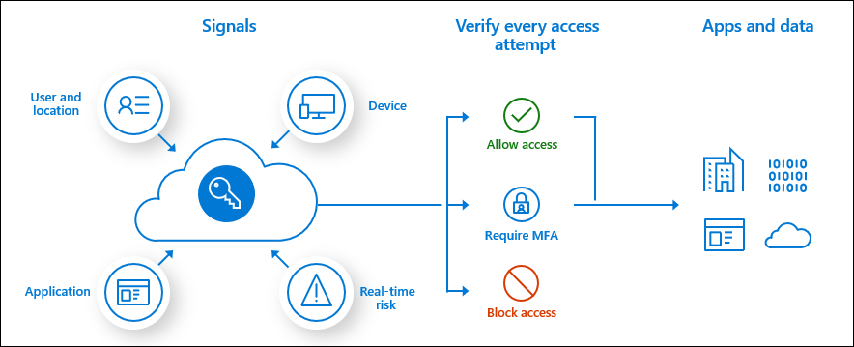
Conditional Access
Conditional Access is used by Azure Active Directory to bring signals together, to make decisions, and enforce organizational policies.
Signals :
User or Group Membership
IP Location
Device
Application
Risk Detection
Decisions :
Block access
Grant access
Actions :
Commonly applied policies
Signals ----> Decisions ----> Actions

Slide 65




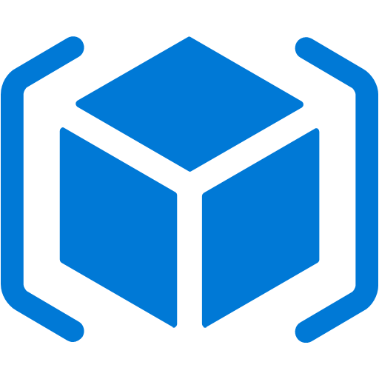
Azure Role-Based Access Control (RBAC)
Fine-grained access management.
Segregate duties within the team and grant only the amount of access to users that they need to perform their jobs.
Enables access to the Azure portal and controlling access to resources.
Azure
Active Directory
Azure
subscription
User
Apps
User groups
Resource group
Resource group

Slide 66
Defense in Depth Model
Physical Security
A layered approach to securing computer systems.
Provides multiple levels of protection.
Attacks against one layer are isolated from subsequent layers.
Identity & Access
Perimeter
Network
Compute
Application
Data

Slide 67
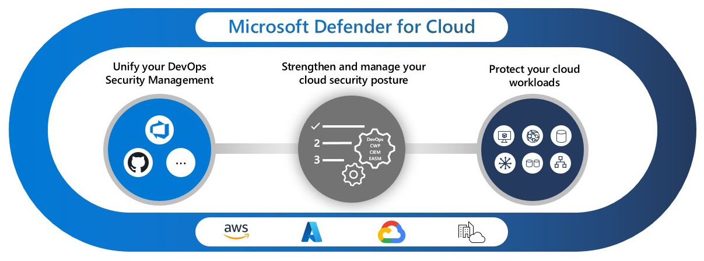
Microsoft Defender for Cloud
Centralized policy management
Security recommendations
Secure score
Multi-cloud coverage
Cloud security posture management

Slide 68
3. Azure Management and Governance
Cost Management
Tools for Governance and Compliance Compute and Networking Services
Tools for Managing and Deploying Azure Resources
Monitoring Tools

Slide 69
3.A. Cost Management
Factors affecting Costs
Pricing Calculator & Total Cost of Ownership(TCO) Calculator
Azure Cost Management
Purpose of Tags

Slide 70
Factors affecting Costs
There are six primary factors affecting costs:
1) Resource Type | 2) Services | 3) Location
Costs are resource-specific, so the usage that a meter tracks and the number of meters associated with a resource, depend on the resource type. | Azure usage rates and billing periods can differ between Enterprise, Web Direct, and CSP customers. | The Azure infrastructure is globally distributed, and usage costs might vary between locations that offer Azure products, services, and resources.
4) Bandwidth | 5) Reserved Instances | 6) Azure Hybrid Use Benefit
Some inbound data transfers are free, such as data going into Azure datacenters. For outbound data transfers, such as data going out of Azure datacenters, pricing is based on Zones. | With Azure Reservations, you commit to buying one-year or three-year plans for multiple products. Reservations can significantly reduce your resource costs up to 72% on pay-as-you-go prices. | For customers with Software Assurance, Azure Hybrid Benefit allows you to use your on-premises licenses on Azure at a reduced cost.

Slide 71
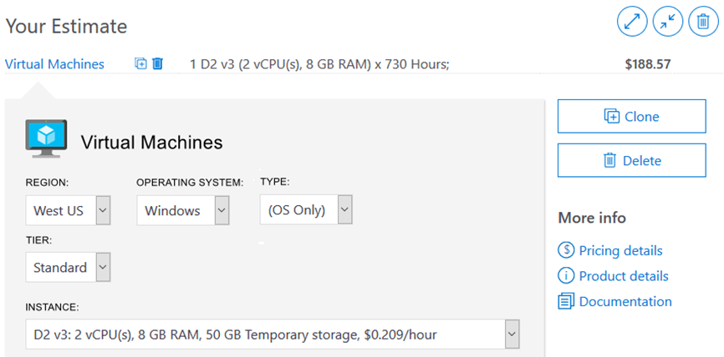
Pricing Calculator
The Pricing Calculator is a tool that helps you estimate the cost of Azure products. The options that you can configure in the Pricing Calculator vary between products, but basic configuration options include:
Region
Tier
Billing options
Support options
Programs and offers
Azure dev/test pricing

Slide 72
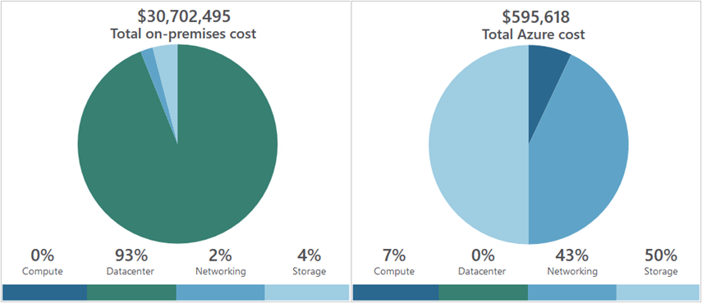
Total Cost of Ownership (TCO) Calculator
A tool to estimate cost savings you can realize by migrating to Azure.
A report compares the costs of on-premises infrastructures with the costs of using Azure products and services in the cloud.

Slide 73
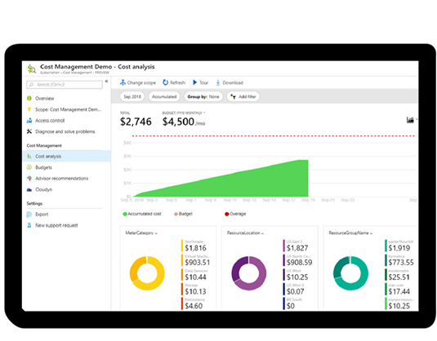
Azure Cost Management
Reporting – billing reports
Data enrichment
Budgets – set spend budget
Alerting – when cost exceed limits
Recommendation – cost recommendations

Slide 74
Tags
Provides metadata for your Azure resources.
Logically organizes resources into a taxonomy.
Consists of a name-value pair.
Very useful for rolling up billing information.
OR
owner: joe
department: marketing
environment: production
cost-center: marketing

Slide 75
Minimizing Costs
Perform
Perform cost analyses. Use the Azure Pricing and TCO calculators.
Monitor
Monitor usage with Azure Advisor. Implement recommendations.
Use
Use spending limits. Use via free trial customers and some credit-based Azure subscriptions.
Use
Use Azure Reservations and Azure Hybrid Benefit (HUB).
Choose
Choose low-cost locations and regions. If possible, use low-cost locations.
Keep
Keep up-to-date with the latest Azure customer and subscription offers.
Apply
Apply tags to identify cost owners. Identify usage owners with tags.

Slide 76
3.B. Tools for Governance and Compliance
Azure Blueprints
Azure Policy
Resource Locks
Service Trust Portal

Slide 77

Azure Blueprints
Azure Blueprints makes it possible for development teams to rapidly build and stand-up new environments. Development teams can quickly build trust through organizational compliance with a set of built-in components (such as networking) in order to speed up development and delivery.
Role Assignments
Policy Assignments
Azure Resource Manager Templates
Resource Groups

Slide 78

Azure Policy
Azure Policy helps to enforce organizational standards and to assess compliance at-scale. Provides governance and resource consistency with regulatory compliance, security, cost, and management.
Evaluates and identifies Azure resources that do not comply with your policies.
Provides built-in policy and initiative definitions, under categories such as Storage, Networking, Compute, Security Center, and Monitoring.

Slide 79
Resource locks
Protect your Azure resources from accidental deletion or modification.
Manage locks at subscription, resource group, or individual resource levels within Azure Portal.
Lock Types | Read | Update | Delete
CannotDelete | Yes | Yes | No
ReadOnly | Yes | No | No

Slide 80
3.C. Tools for Managing and Deploying Azure Resources
Azure Portal
Azure PowerShell
Azure CLI
Azure Cloud Shell
Azure Resource Manager

Slide 81




Management Tools in Azure
Azure PowerShell
Azure Portal
Connect-AzAccount : log in to azure
Get-AzResourceGroup : list resource groups
New-AzResourceGroup : create new resource group
New-AzVm : create virtual machine
Public web-based interface for management of azure platform
Azure CLI
Azure Cloud Shell
az login : log into azure
az group list : list resource groups
az group create : create new resource group
az vm create : create virtual machine
Cloud based scripting environment
Completely free
Supports both Azure PowerShell and Azure CLI

Slide 82
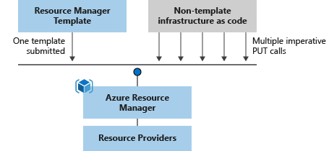
Azure Resource Manager (ARM) templates
Azure Resource Manager (ARM) templates are JavaScript Object Notation (JSON) files that can be used to create and deploy Azure infrastructure without having to write programing commands.
Declarative syntax
Repeatable results
Orchestration
Modular files
Built-in validation
Exportable code

Slide 83
3.D. Monitoring Tools in Azure
Azure Advisor
Azure Service Health
Azure Monitor including Log Analytics, Azure Monitor Alerts, and Application Insights

Slide 84

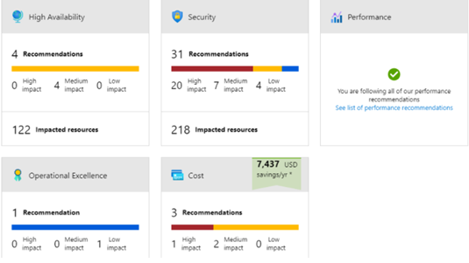
Azure Advisor
Azure Advisor analyzes deployed Azure resources and makes recommendations based on best practices to optimize Azure deployments.
Reliability
Security
Performance
Cost
Operational Excellence
© Copyright Microsoft Corporation. All rights reserved.

Slide 85

Azure Service Health
Service Health keeps you informed about the health of your environment
It provides a personalized view of the status of your Azure services and regions
includes information about planned maintenance and current incidents

Slide 86

Azure Monitor
Azure Monitor maximizes the availability and performance of applications and services by collecting, analyzing, and acting on telemetry from cloud and on-premises environments.
Application Insights
Log Analytics
Smart Alerts
Automation Actions
Customized Dashboards

Slide 87
Useful Resources
Microsoft Learn | Microsoft Docs
Learn TV | Microsoft Docs
Azure | Tags | Channel 9 (msdn.com)
Microsoft Azure – YouTube
Welcome | Azure Tips and Tricks (microsoft.github.io)
Azure Blog and Updates | Microsoft Azure
Microsoft Certifications | Microsoft Docs

Slide 88
THANK YOU

